Slide 1
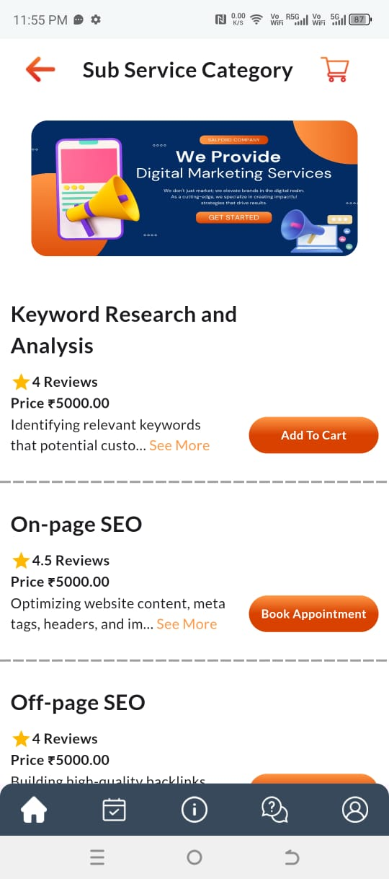
Key word research & Analysis: 1000 rs up to 20 page website Key word suggestions: 1000 Rs
On Page Seo-
Starts around- 1000 Rs per month.
Book Initial consultation-500 Rs (Includes SEO plan,Comparison with competitor and out come report and time lines.
Off Page-Same as On page SEO

Slide 2
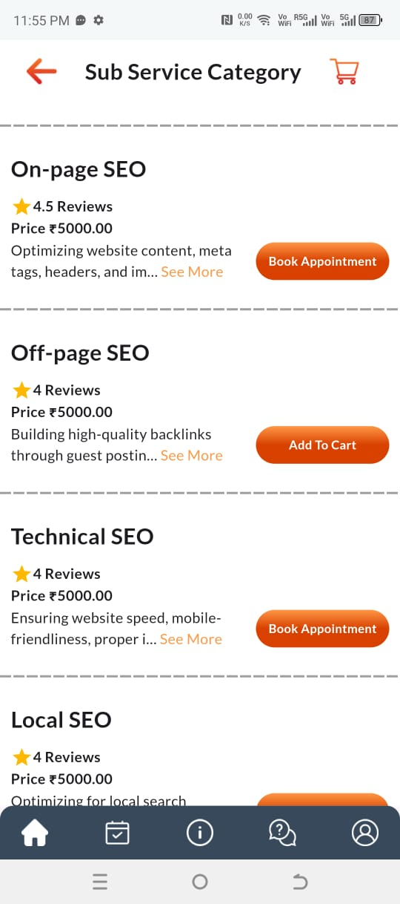
Technical SEO- Starts around- 2000 rs per month
Consultation at -1000 Rs
Inclusive of content assessment by subject matter expert along with digital marketing team.
Complete report including competitor analysis,Website ranking and projections
Recommended for Technical products/
Local SEO-
Starts around 1000 Rs per month
Consultation at -500 Rs
Recommended for small business owners

Slide 3
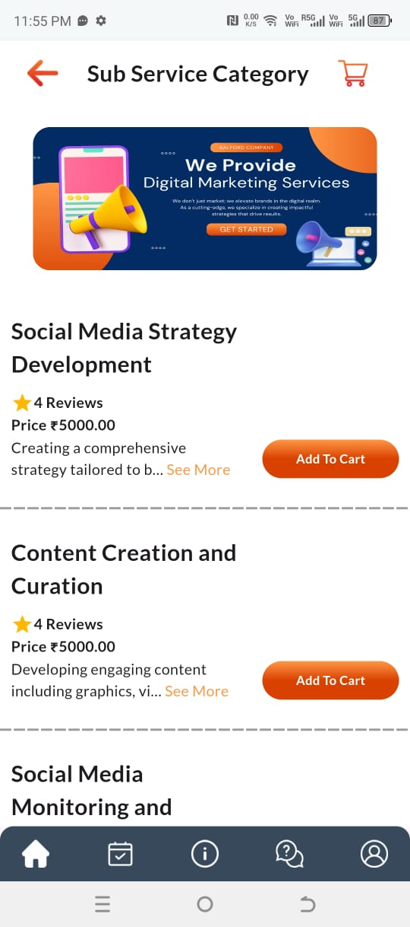
1.Starts around 1000 rs per month.
Consultation at -1000 Rs
Price varies depending upong the platform and level of content requirements.
2.Content creation;
Starts around 300 rs per post.
Consultation is free.

Slide 4
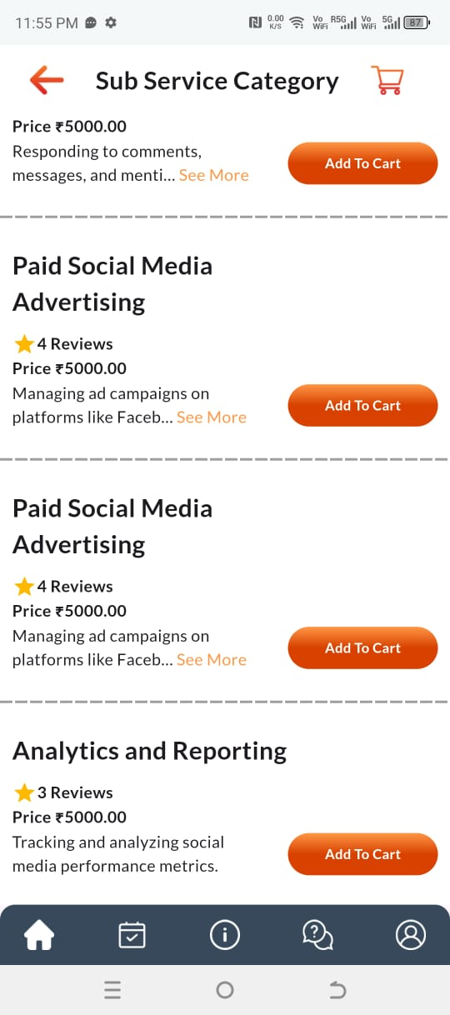
Paid Social media-
Starts around 3000 rs per month.
Consultation-500 rs
Remove duplicate entries.
Analytics and reporting:
1000 rs per month (2 reports)
600 rs per 1 report.

Slide 5
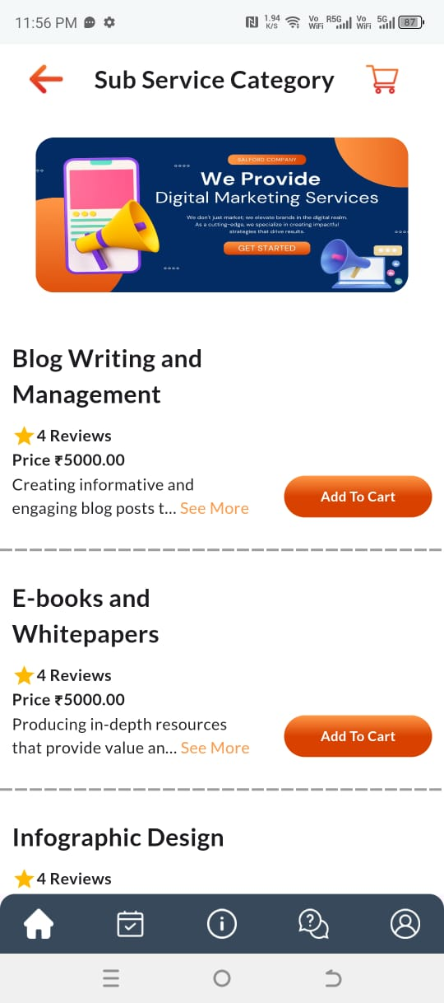
Blog writing:
Starts at 500 rs per blog post up to 300 words
Needed more lets talk for customized quote free consultation.
E-books:
Starts at 1000 rs per e book and white papers.
Needed more lets talk free consultation.
Infographic design:
Starts at 200 rs per post.
Will vary according to the type of infographics.

Slide 6
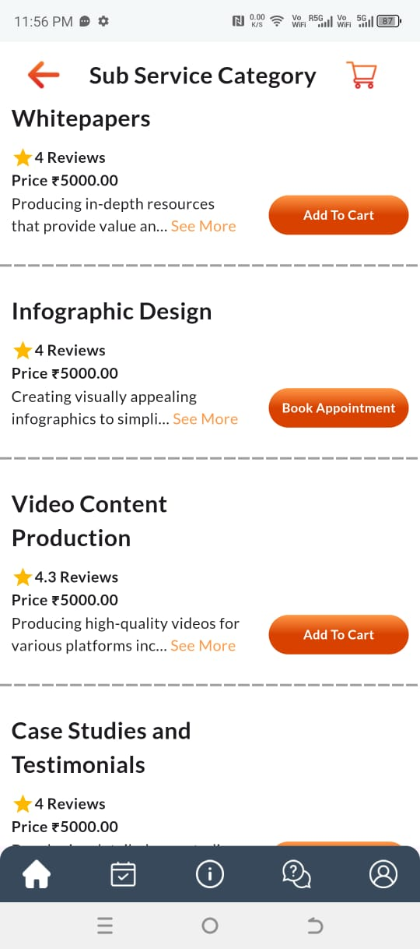
White papers-Start around 1000 rs per paper.
Lets talk for a customized quote.
Inforgraphic-Remove
Video content:
Start from 1000 rs per video.
Lets talk for a quote.
Case studies:
Starts from 500 rs.

Slide 7
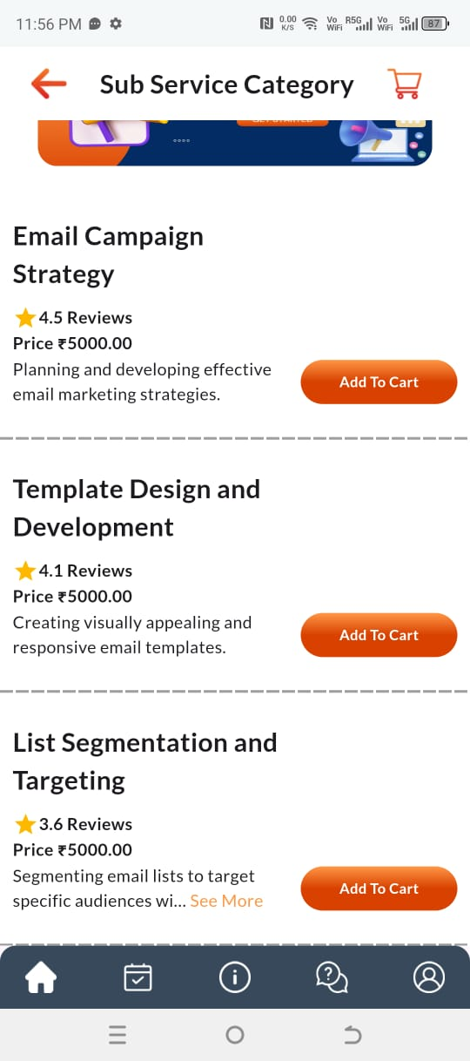
Email campaign-Starts around 1000 rs per month.
Consultation- 500 rs.
Which includes suggesting of suitable campaigns and assessment of current methods and domain reputation.
Template design and development:
Starts around 500 rs per template.
Customized quote:
Lets talk
List segmentation:
Starts around 500 rs;
Customized quote.

Slide 8
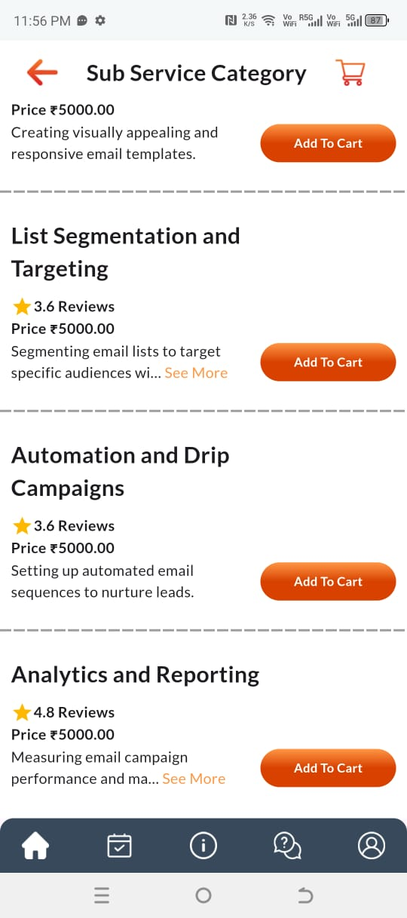
Automation & Drip campaigning:
Starts around 2000 rs per month.
Consultation- 1000 rs.
Including suggestion of suitable automation method,tools and basic process steps.

